Slide 1

MULTIPLE DISEASE PREDICTION

Slide 2
Presented by - Arshpreet Kaur Ghotra B-tech (ECE) semester-6th Roll number- 17042011168
Submitted To - Dr. Jaipreet Kaur

Slide 3
OBJECTIVE
Now a days , it is very useful for post covid contactless system in rural health service.
The goal is to provide access to medical specialist .
Our main aim is to provide a quick medical diagnosis to the patients living in rural areas .
This system enhance quality of health care .

Slide 4
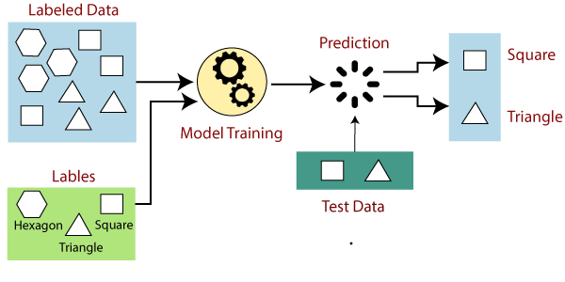
Introduction Machine Learning Approach for Identifying Multiple Disease Prediction Using Machine Learning is based on prediction modelling that predicts disease of the patients according to the Laboratory test measures provided by the users as an i/p to the system.
Concept

Slide 5
Software required 1. Google Colab Notebook 2. Anaconda. 3. Pycharm. Working So, before execution we have some pre-requisites that we need to download or install i.e., anaconda environment, Pycharm and a code editor (Google colab Notebook) . Google colab notebook: Google colab allows anybody to write and execute arbitrary python code through the browser, and is especially well suited to machine learning, data analysis and education. Anaconda: Anaconda is like a package of libraries and offers a great deal of information which allows a data engineer to create multiple environments and install required libraries easy and neat. PyCharm : PyCharm is a dedicated Python Integrated Development Environment (IDE) providing a wide range of essential tools for Python developers, tightly integrated to create a convenient environment for productive Python, web, and data science development.

Slide 6
Block Diagram
Machine learning
Algorithms
Performance analysis
Diabetes Disease
Preprocessing
. Handle missing values
. Standardization
.Support vector machine
.Logistic Regression
Test Data Accuracy
Heart Disease
Parkinson’s Disease

Slide 7
P
R
O
Preprocessing the data
Check Null values
Splitting the data
Training data
Standardize the data
Testing data
C
E
S
Apply machine learning Algorithm
Support vector machine
Performance Analysis or accuracy
Without SMOTE
Logistic regression
With SMOTE
S

Slide 8
Conclusion The main aim of this project is to predict the disease in accordance with parameters of Laboratory reports put down by the patients with proper implementation of Machine Learning algorithm. In this project we have used 2 Machine Learning algorithm for prediction and achieved the mean accuracy of more than 84% which shows remarkable rectification and high accuracy than previous work and also makes this system more reliable than the existing one for this job and hence provides better satisfaction to the user in comparison with the other one.

